Slide 1
ARTIFICIAL NEURAL NETWORKS
Single Layer of Neurons
(Single Layer Neural Network)
Muhammad Shahid

Slide 2
ARTIFICIAL NEURAL NETWORKS
Single Layer of Neurons
A single neuron with unit step activation function can classify the input into two categories
A
A = 0
B = 1
B

Slide 3
ARTIFICIAL NEURAL NETWORKS
Single Layer of Neurons
However, we can also use one neuron to classify only one class. The neuron decides whether the input belongs to its class or not
This configuration has the disadvantage that the network size become large
However, it has the advantage that an input may be placed in more than one class, or in none of the classes.

Slide 4
ARTIFICIAL NEURAL NETWORKS
Single Layer of Neurons
Two neurons for two categories
A
¬ B
A = 1
¬A = 0
¬ B
¬A
B = 1
¬ B = 0
B
B
A
¬A

Slide 5
ARTIFICIAL NEURAL NETWORKS
Single Layer of Neurons
Two neurons with unit step activation function can classify the input into four categories
00
A = 0
B = 1
10
A = 0
B = 1
01
11

Slide 6
ARTIFICIAL NEURAL NETWORKS
Single Layer of Neurons
For single layer neurons, each neuron of the network can be considered as an independent neuron

Slide 7
ARTIFICIAL NEURAL NETWORKS
Single Layer of Neurons
Four neurons for four categories
A = 1
A
A = 0
C = 1
B
C
D
B = 1
D = 1

Slide 8

ARTIFICIAL NEURAL NETWORKS
Single Layer of Neurons
A single layer of neurons cannot classify the input patterns that are not linearly separable
To be able to learn such functions, neurons are required to be arranged in two or more layers

Slide 9
ARTIFICIAL NEURAL NETWORKS
Example: Character Recognition

Slide 10
ARTIFICIAL NEURAL NETWORKS
Single Layer Network
Example: Character Recognition
Consider that we have some input patterns of the letter “A” and others of not “A”
The patterns belong to different fonts
We train a neuron to classify each of these vectors as belonging, or not belonging, to the class “A” (1 or -1)
There are 3 examples of “A” and 18 examples of not “A”

Slide 11
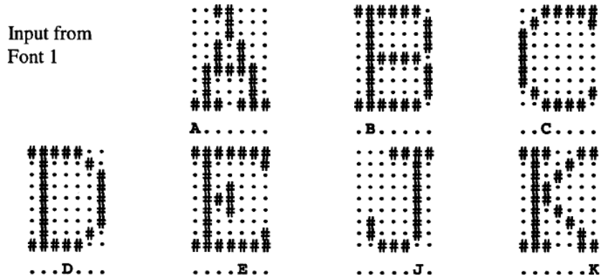
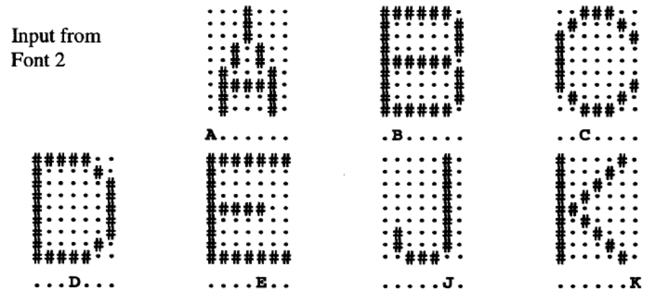
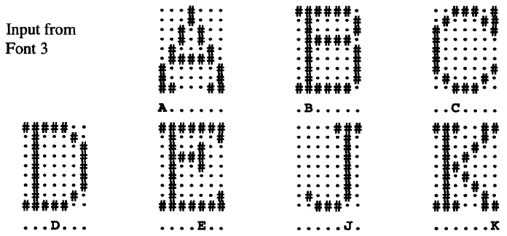
ARTIFICIAL NEURAL NETWORKS
Single Layer Network

Slide 12
ARTIFICIAL NEURAL NETWORKS
Single Layer Network
We can use the same training samples as examples of B and not B, and train another neuron in a similar manner
Note that the weights of the neuron for “A” have no interaction with the weights for the neuron for “B”
Therefore, we can solve these two problems at the same time by having 2 neurons
Continuing with this idea, we can have 7 neurons, one for each category

Slide 13
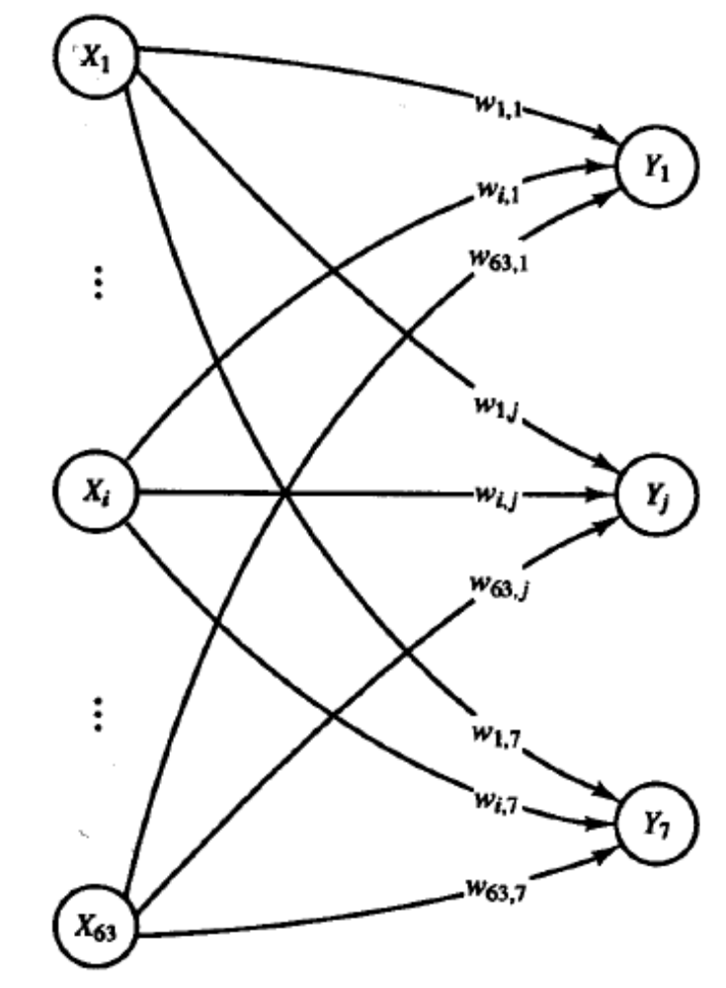
ARTIFICIAL NEURAL NETWORKS
Single Layer Network

Slide 14
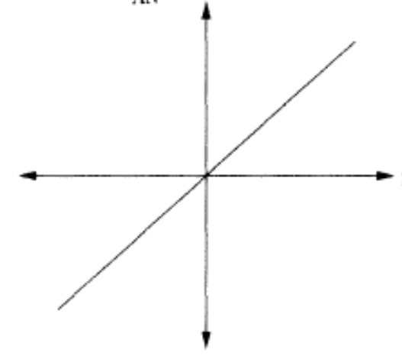
ARTIFICIAL NEURAL NETWORKS
Activation Functions
Linear Function
y = f(act) = γ * act
The neuron output is simply equal to the weighted sum of the inputs. It may be modulated by a constant factor γ

Slide 15
ARTIFICIAL NEURAL NETWORKS
Activation Functions

Slide 16
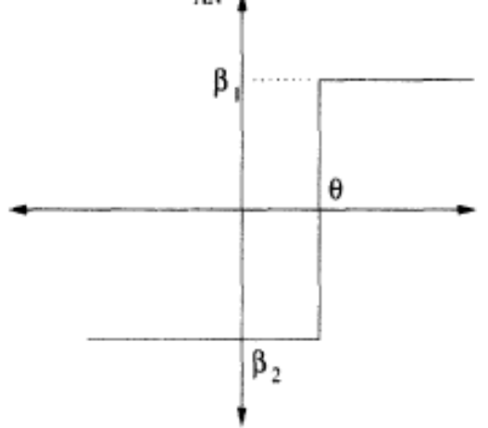
ARTIFICIAL NEURAL NETWORKS
Activation Functions
Step Function
y = f(act) = β₁ If act ≥ 0
= β₂ If act < 0
For the step function only
one of the two scalar values
are possible at the output
Usually (β₁, β₂) are taken as (1, -1) or (1, 0)

Slide 17
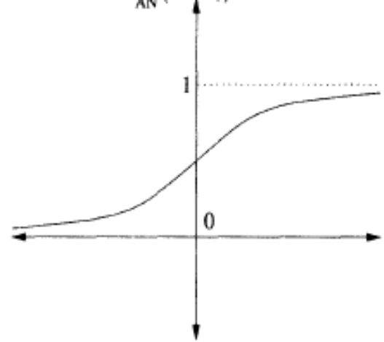
ARTIFICIAL NEURAL NETWORKS
Activation Functions
Sigmoid Function (Logistic function)
y = f(act) = 1
1 + e^{– λ(act)}
The sigmoid function is a continuous version of the ramp function
The parameter λ controls the steepness of the function. Large λ makes it almost a unit step function.
Usually λ = 1

Slide 18
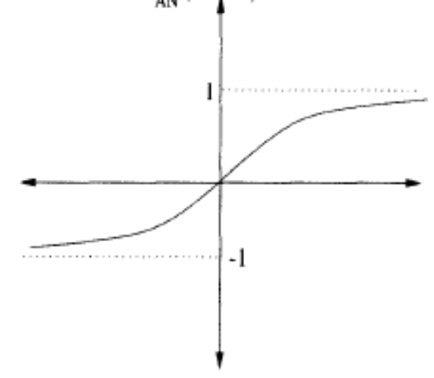
ARTIFICIAL NEURAL NETWORKS
Activation Functions
Hyperbolic Tangent Function
y = f(act) = e^{λ(act)} - e^{– λ(act)}
e^{λ(act)} + e^{– λ(act)}
= 2 - 1
1 + e^{– λ(act)}
The output of this function is in the range (-1, 1)

Slide 19
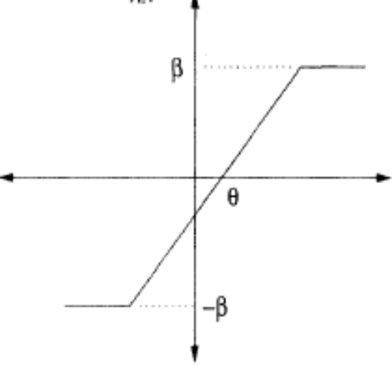
ARTIFICIAL NEURAL NETWORKS
Activation Functions
Ramp Function mxzc
y = f(act) = β If act ≥ β
= act If -β < act < β
= -β If act ≤ -β
It is a combination of the linear and step functions

Slide 20
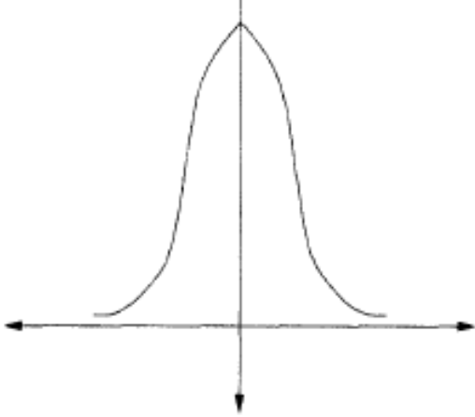
ARTIFICIAL NEURAL NETWORKS
Activation Functions
Gaussian Function
y = f(act) = e^{-θ}
where θ = (act)²/σ²
Where σ² is the variance of the Gaussian distribution

